Slide 1

Logic Apps & Functions
Chet Hartin – 10/3/20

Slide 2
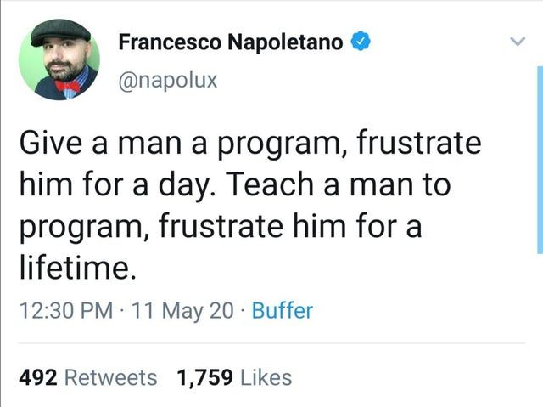

Slide 3

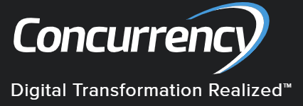
About Me
Name: Chester (Chet) Hartin
Job: Technical Architect @ Concurrency
Twitter: @chethartin
Web: http://chesterhartin.com
Git: https://github.com/chesterhartin/
Interests: Music, Programming, Writing

Slide 4
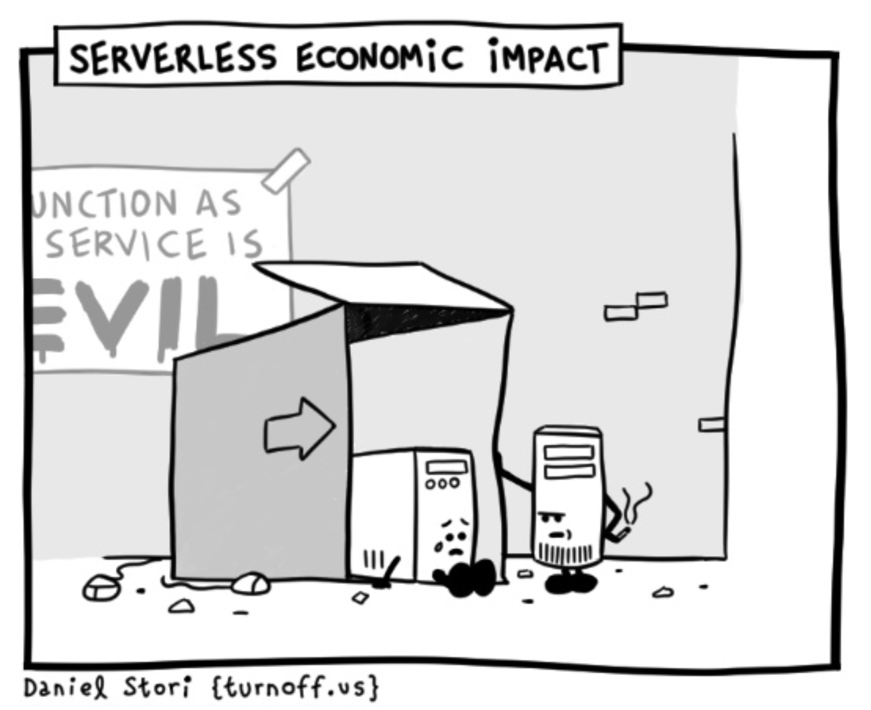
Serverless?
The population of homeless servers is growing

Slide 5
Serverless for the Enterprise
Deployment process flexibility
Secure & Compliant
Enterprise-level scale w/ control
Advanced observability
Hybrid & Multi-Cloud
No Infrastructure to manage (reduce DevOps)
No wasted resources – pay only for what you use (micro-billing)

Slide 6
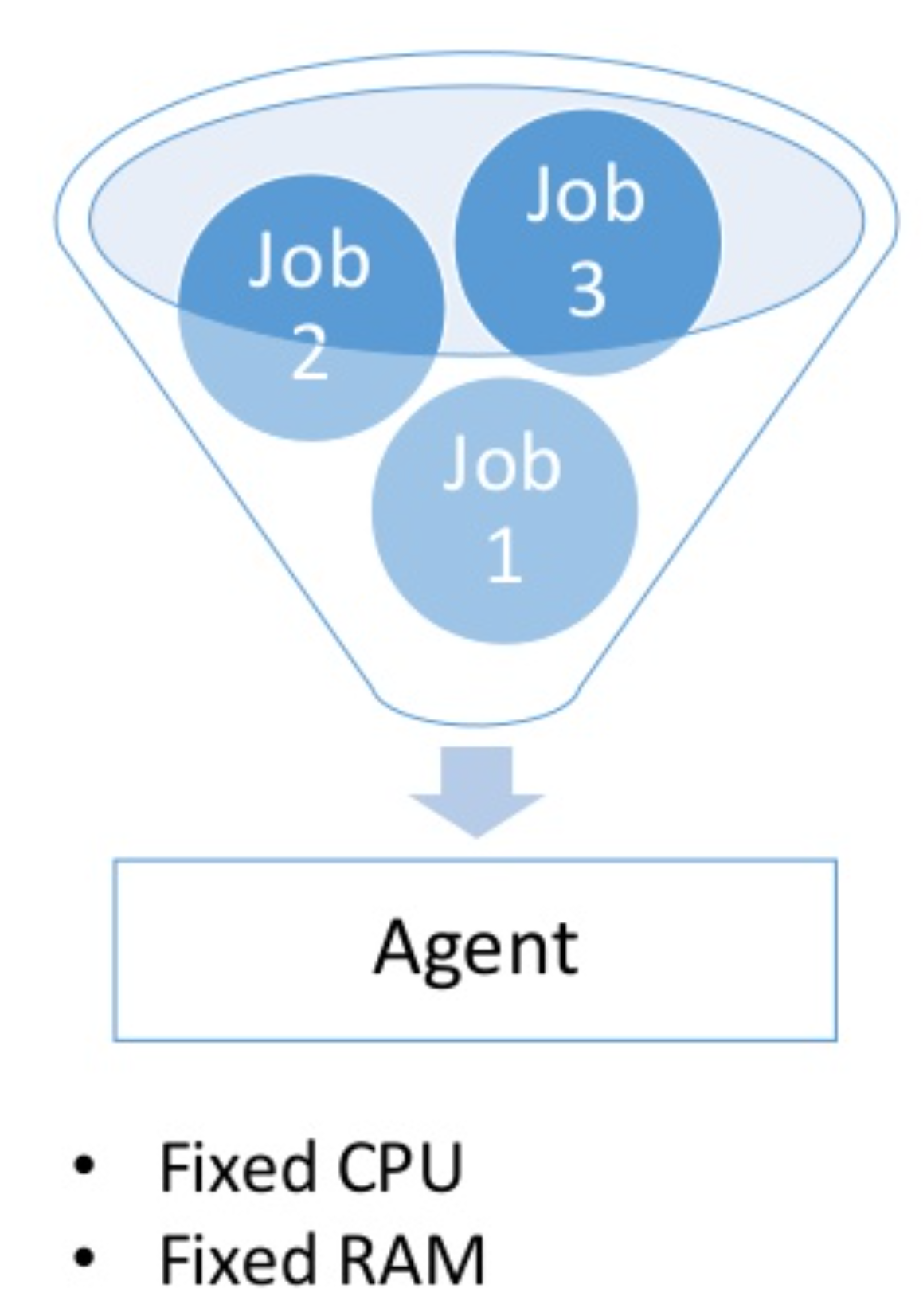
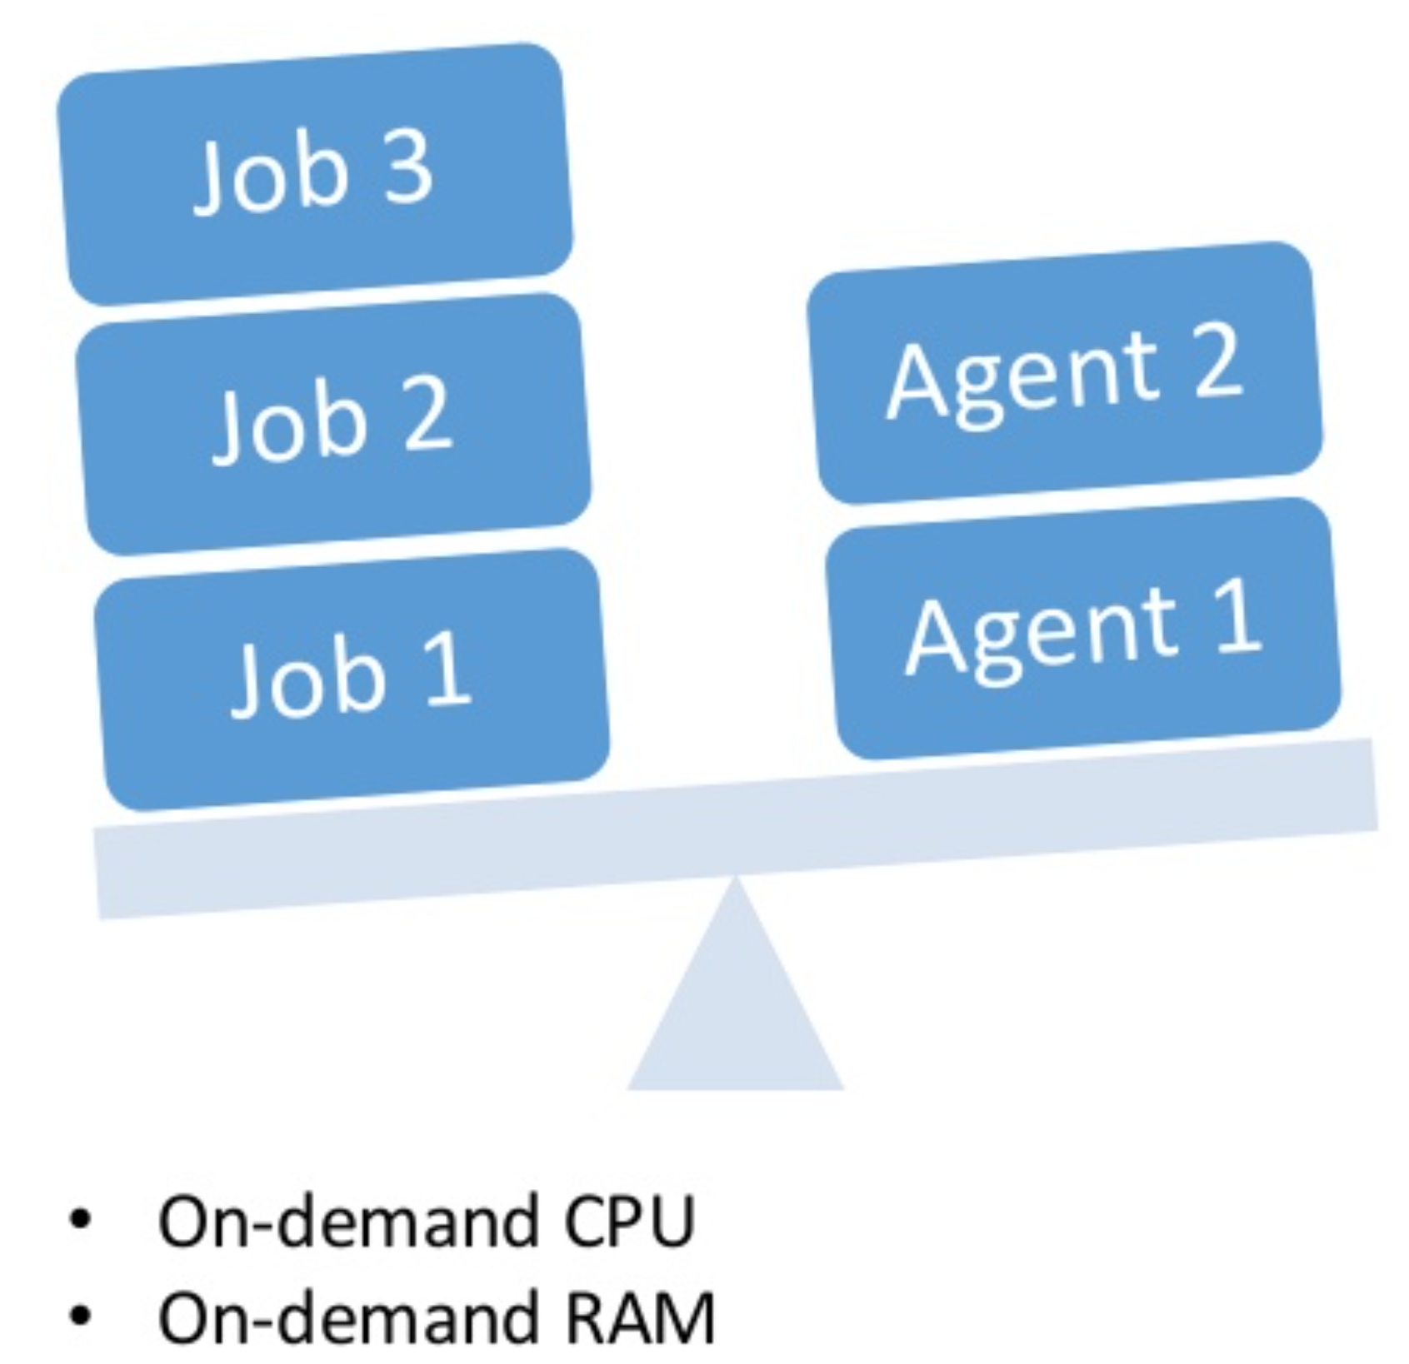
Fixed vs. Need
Reserved
Serverless

Slide 7
Serverless Offerings
Microsoft Azure
AWS
Google
Azure Functions
Azure Logic Apps
Azure Container Instances
AWS Lambda
AWS Fargate
Cloud Functions
Cloud Run

Slide 8
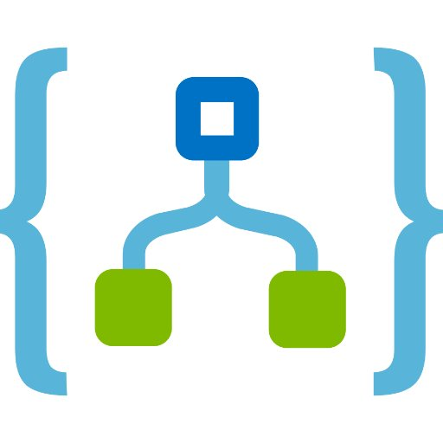
Today
Azure Logic Apps

Slide 9
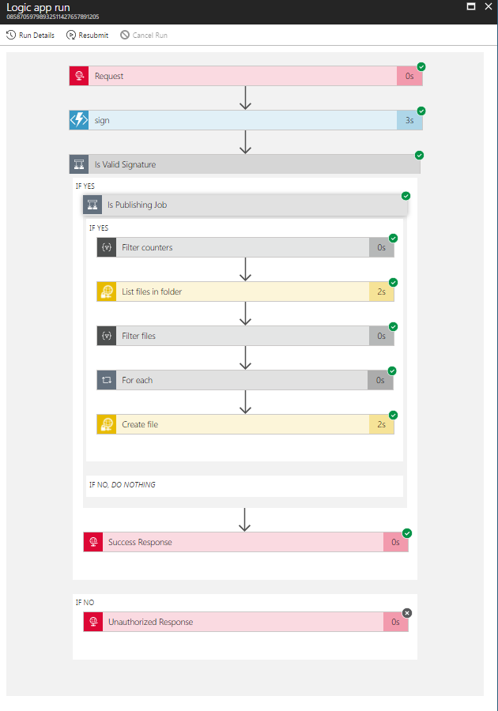
Logic Apps
Visually design workflows in the cloud
Express logic through control flow
Connect disparate functions & APIs
200+ connectors from various cloud services

Slide 10


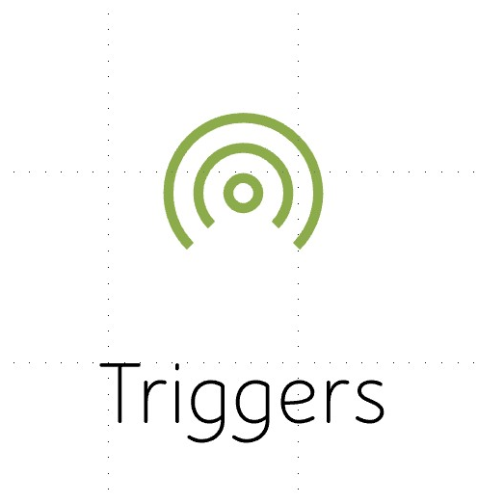
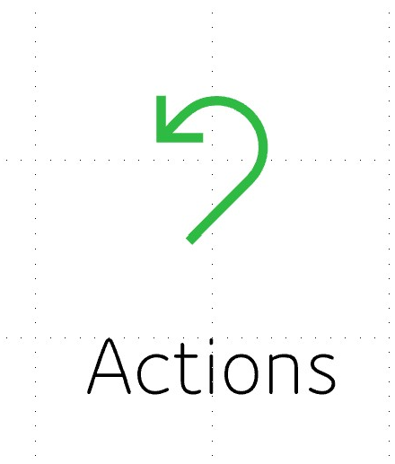
Parts

Slide 11
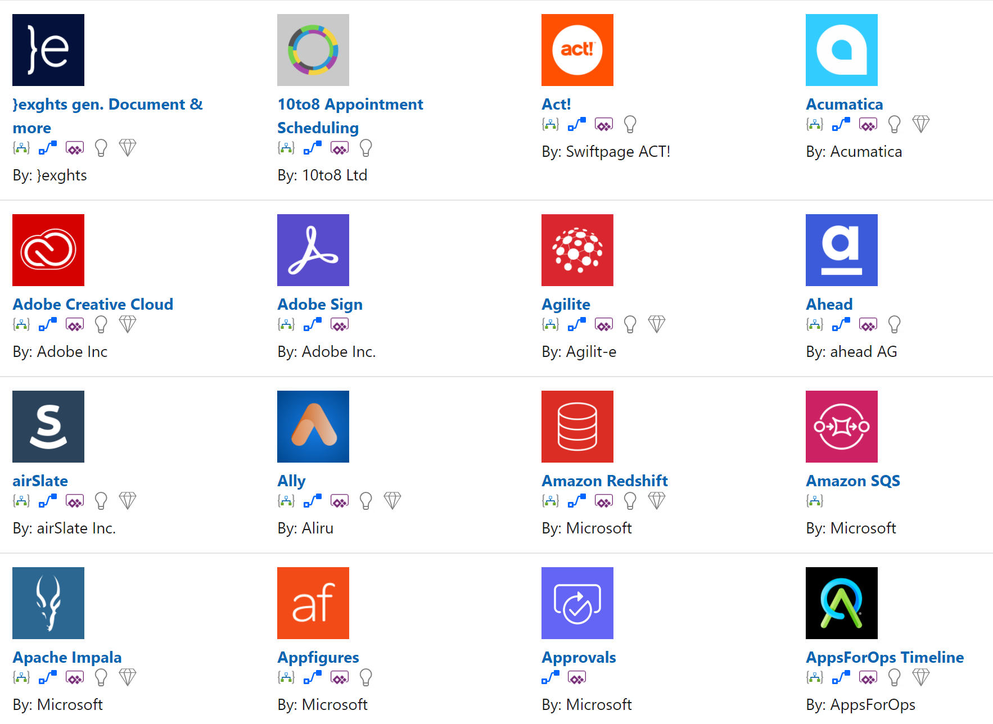
Connectors
Types:
Built-In
Managed
On-Premise
Integration (B2B)
https://docs.microsoft.com/en-us/Connectors/connector-reference/

Slide 12
Connector Parts
Actions
Triggers
Changes directed by a user
All actions directly map to operations
Invoke services (Function apps, Http services, Swagger)
Request/Response
Flow Control, Conditions & Loops
Retry Policies
Notify your app when a specific event occurs
Polling triggers (Scheduled)
Push triggers
On Demand (Webhook)

Slide 13
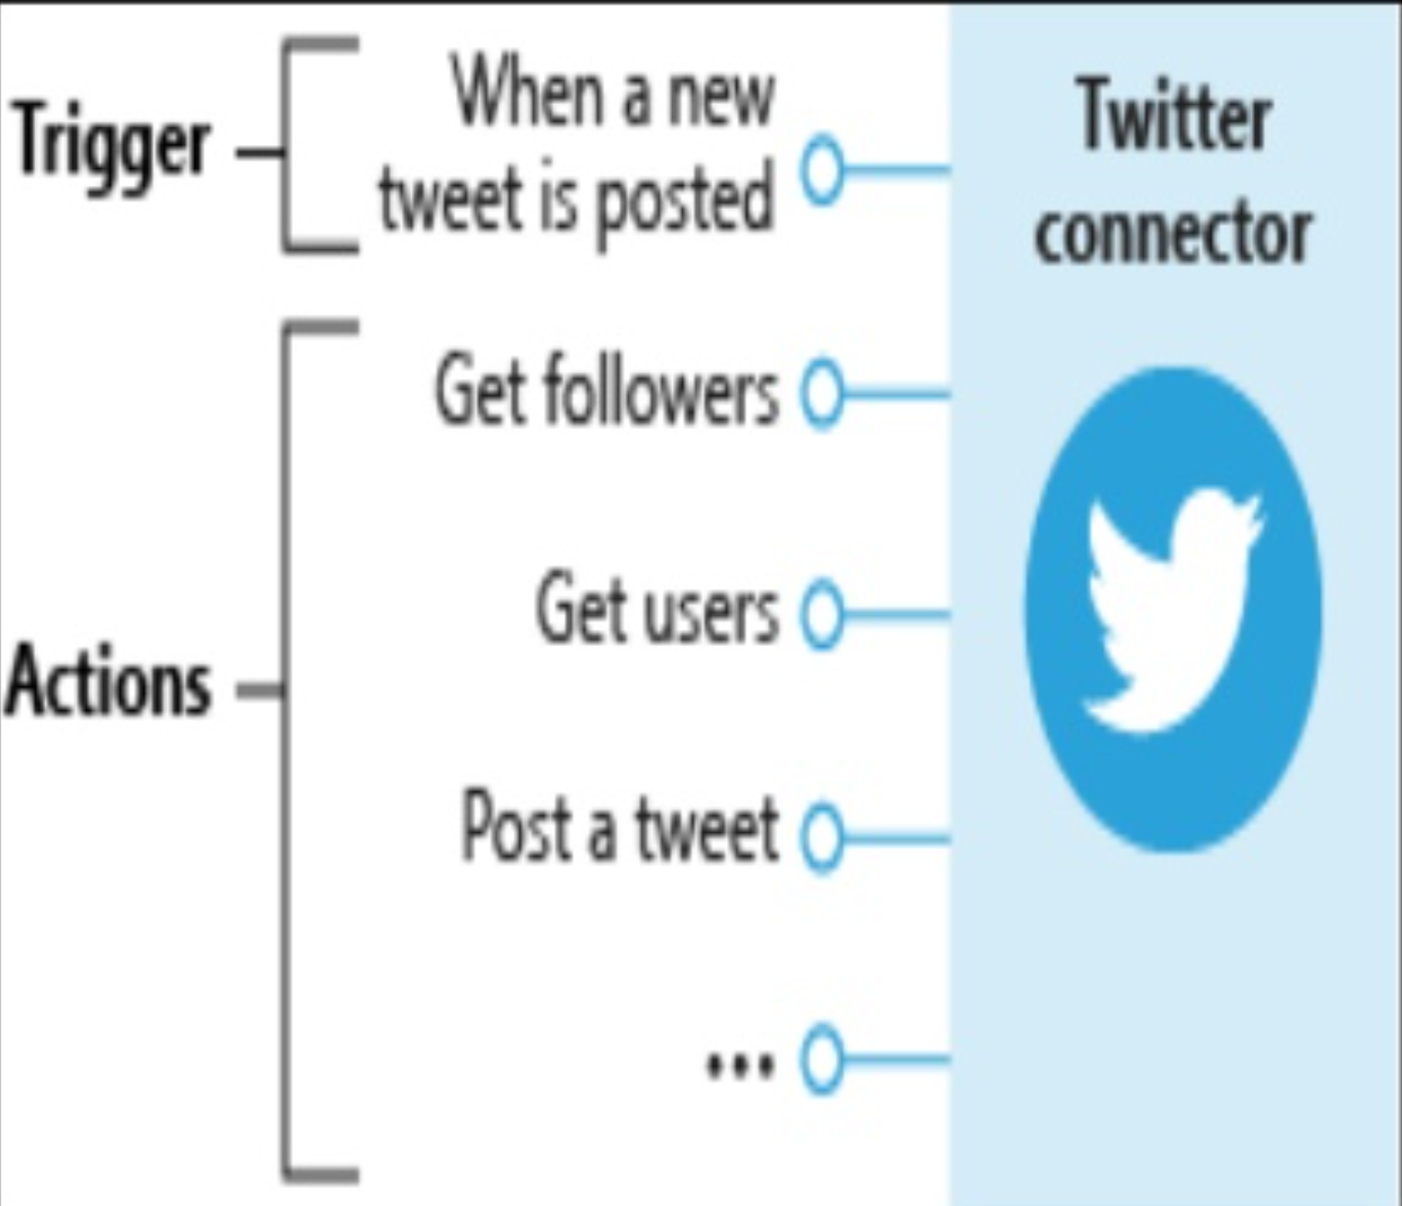
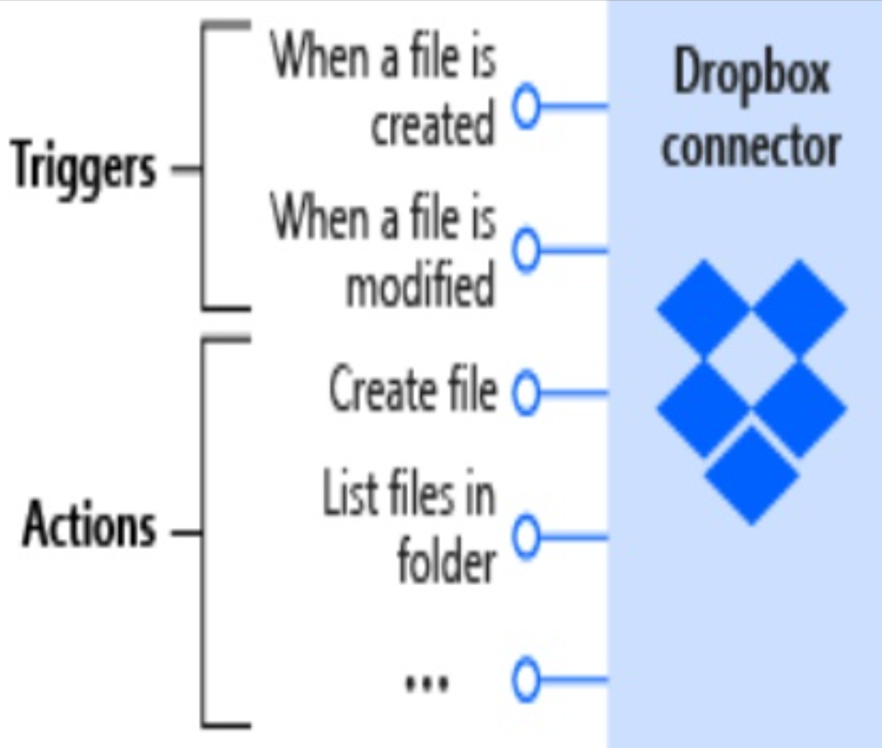
Connectors - Visualized

Slide 14
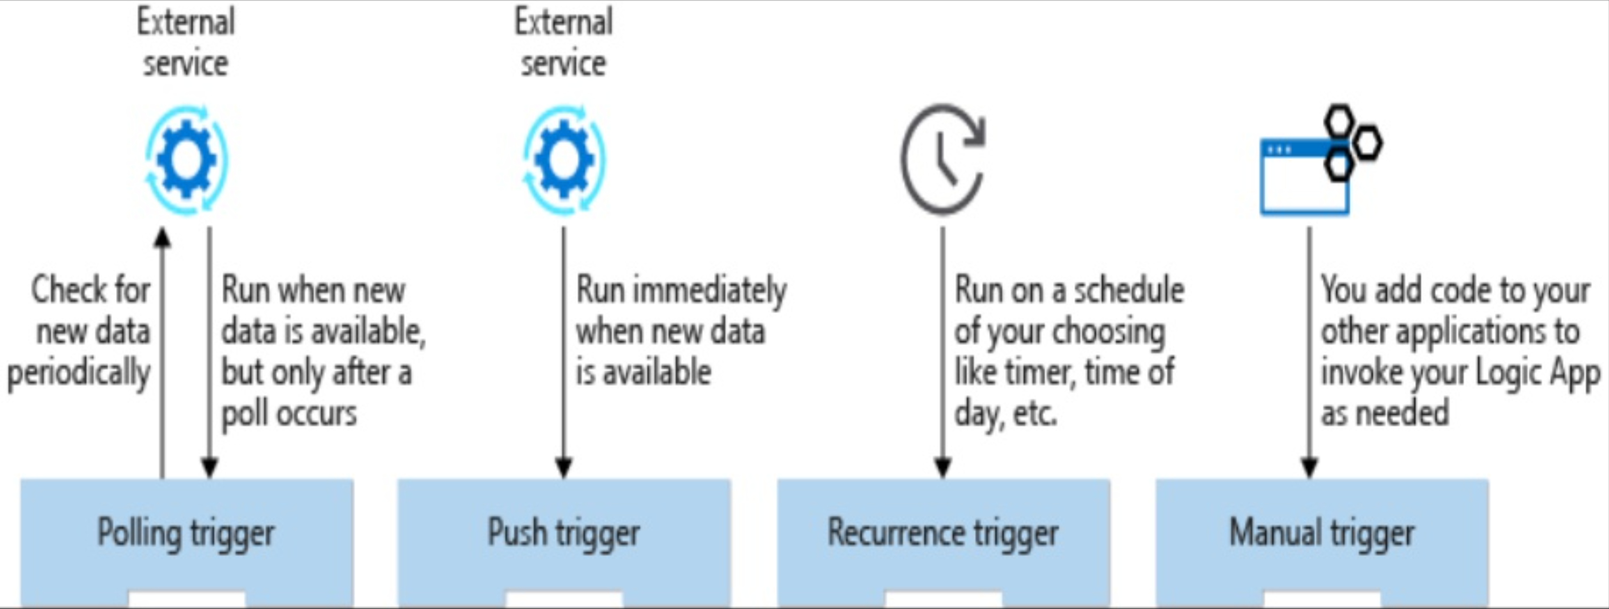
Types of Triggers

Slide 15
Conditions & Flow
Logic Apps give you quite a bit of flow controls out of the box
Condition
Switch
Foreach Loop
Until Loop

Slide 16
Types and operators
Numeric
String
Boolean
JSON Objects
Is-Equal-To
Is-Not-Equal-To
Is-Greater-Than
Is-Greater-Than-Or-Equal-To
Is-Less-Than
Is-Less-Than-Or-Equal-To
Is-Equal-To
Is-Not-Equal-To
Contains
Does-Not-Contain
Starts-With
Does-Not-Start-With
Ends-With
Does-Not-End-With
Is-Equal-To
Is-Not-Equal-To
Is-Equal-To
Is-Not-Equal-To

Slide 17




Walkthrough – Social Media Monitor
Trigger (when a new tweet is posted)
Action (detect sentiment)
Action (insert row)
Action (send email)

Slide 18
Interface Basics

Slide 19
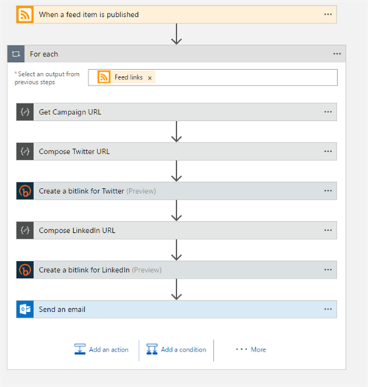
Real World Example – New Post
Requirements
Trigger automatically when a new blog post is published
Create a short link:
For Twitter
For LinkedIn
Send out email w/ links
View URLs in the Bitly dashboard to track click-through-rate

Slide 20
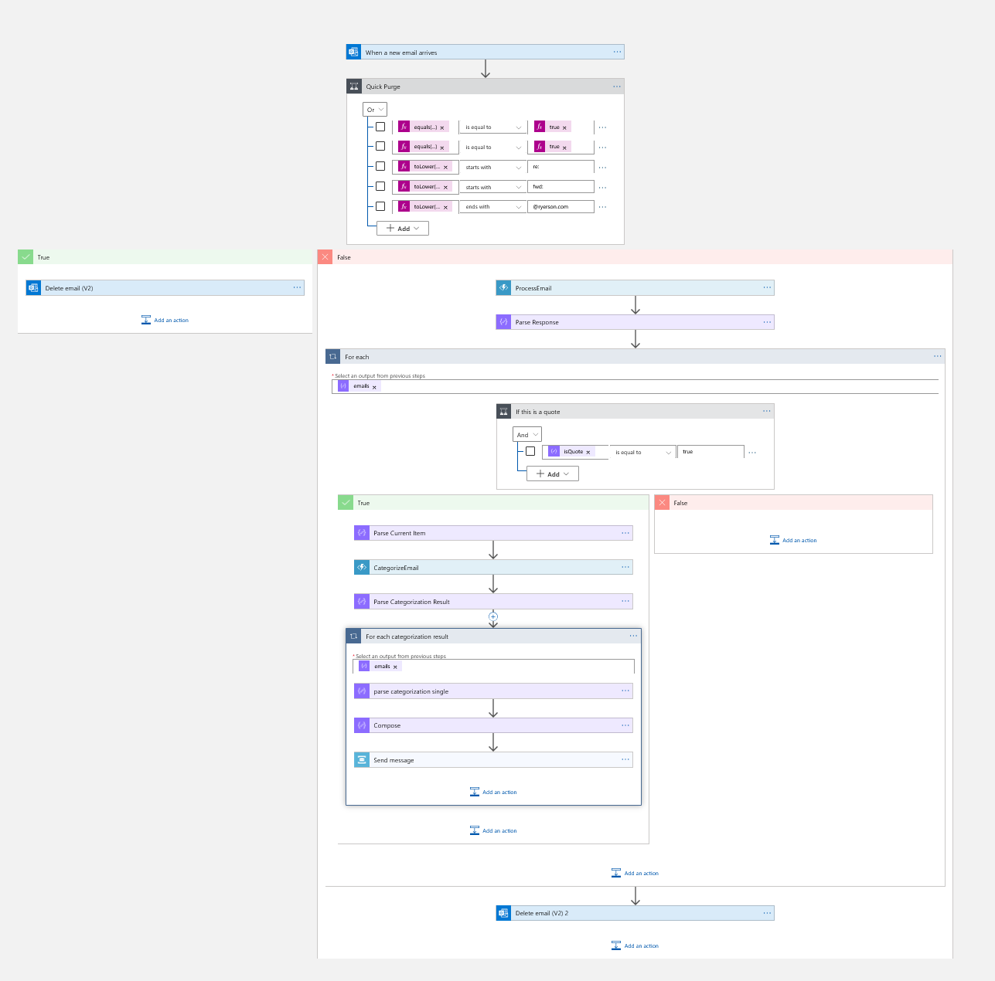
Real World Example
Email Filter / Flagger

Slide 21
Additional Real World: Logic Apps
Detect when a new SQL Record is inserted
Parse Emails
Run JS Code
Upload files from URL
Monitor / Archive Social Media Posts
Cron jobs

Slide 22
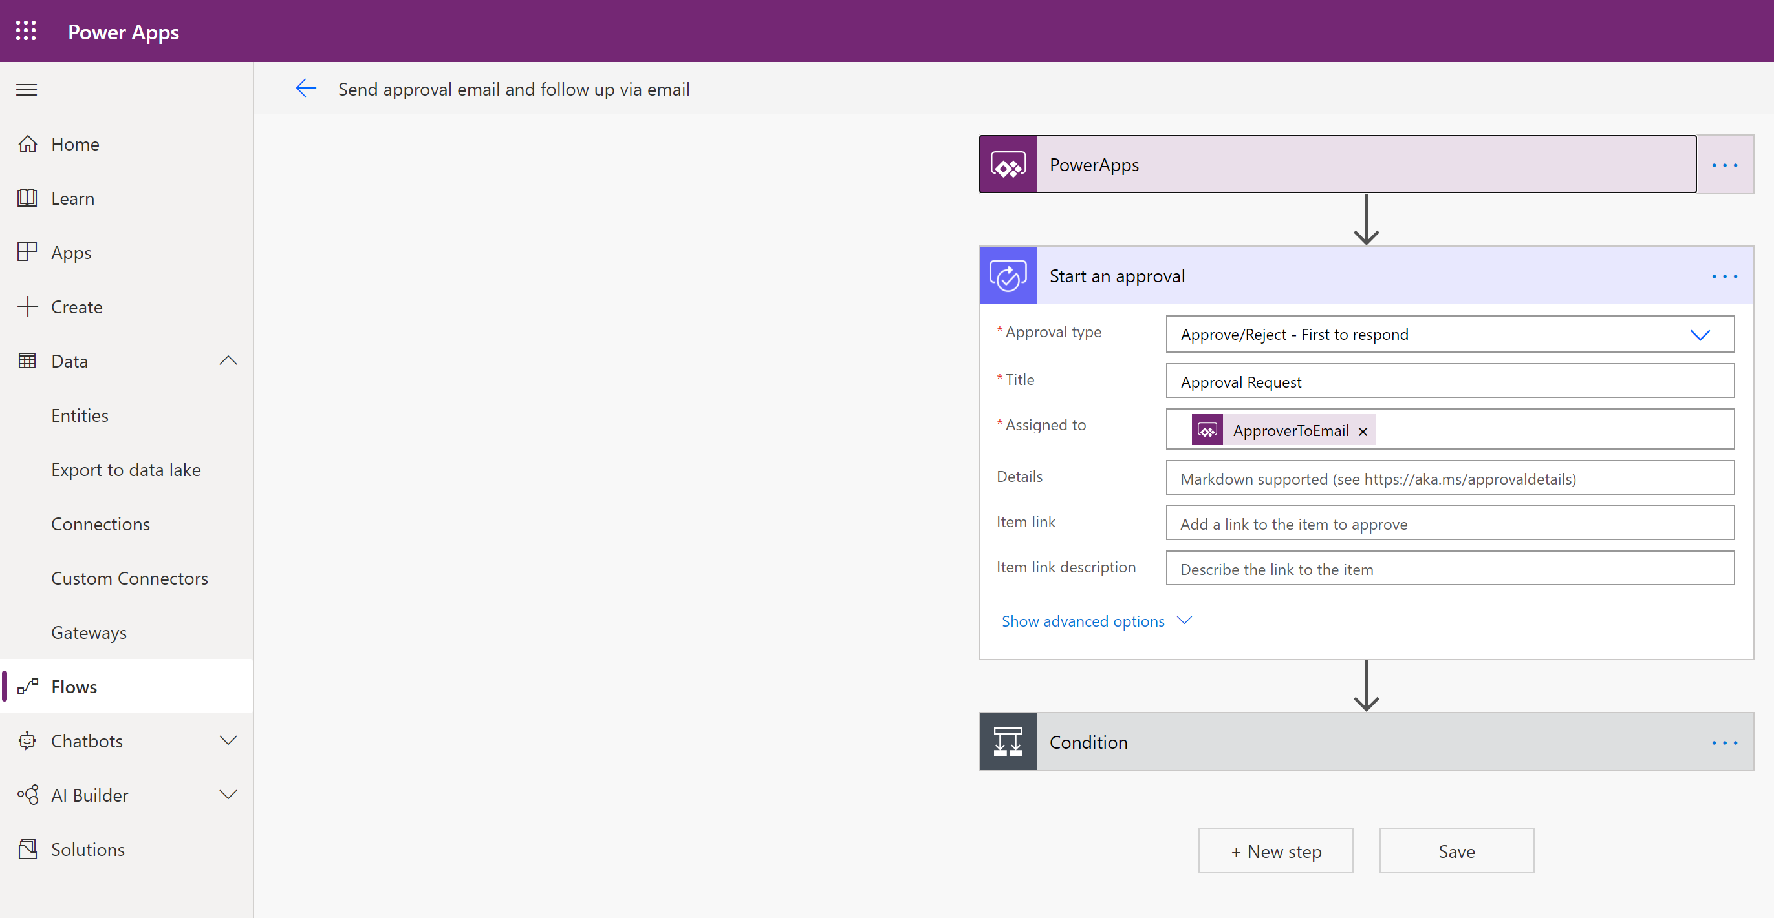
Did you know…
If you know logic apps – you immediately know Microsoft Flow

Slide 23
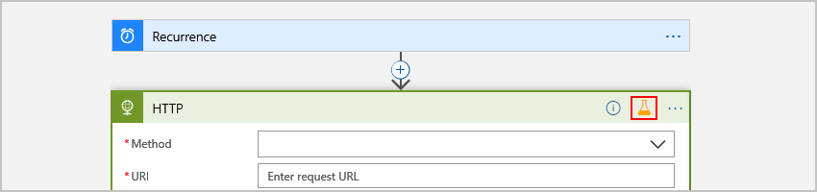
Testing Logic Apps
Logic Apps allow you to “mock” results with Static Results – however, you must manually enable/disable the results. Other than that… it’s mostly manual testing.
Notes:
https://docs.microsoft.com/en-us/azure/logic-apps/test-logic-apps-mock-data-static-results#:~:text=from%20that%20run.-,If%20you%20haven't%20already%2C%20in%20the%20Azure%20portal%2C,has%20the%20outputs%20you%20want.

Slide 24
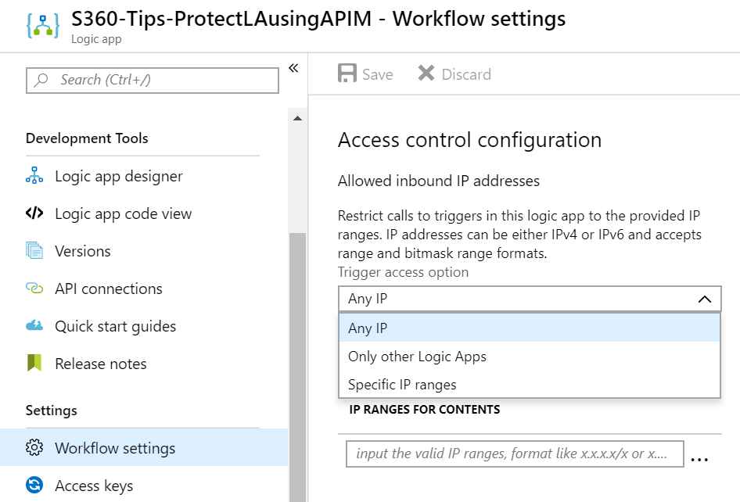
Securing Logic Apps
When you utilize a HTTP Request trigger, it is a publicly exposed endpoint – that said, it does use HTTPs and you can utilize a SAS token.
You can also secure it by:
IP Access Control
Basic / Oauth 2.0 / AAD
Azure API Management
Notes:
https://docs.microsoft.com/en-us/azure/logic-apps/logic-apps-securing-a-logic-app

Slide 25
Deploying Logic Apps
ARM Templates
Terraform
Copy-Paste-Pray
Notes:
https://docs.microsoft.com/en-us/azure/logic-apps/logic-apps-deploy-azure-resource-manager-templates

Slide 26
Code I Wish I Had 2 years ago
Dynamic ids/names: subscription().id / resourceGroup().name
Using parameters: [parameters('yourparamnamehere’)]
Looking up resources: [resourceId('Microsoft.Web/connections', parameters('yourparamnamehere’))]
Putting it all together: [concat('/subscriptions/',subscription().subscriptionId,'/resourceGroups/',resourceGroup().name,'/providers/Microsoft.Web/sites/',parameters('yourparamnamehere'), '/functions/yourfunctionnamehere’)]
Making it web safe: [concat('/@{encodeURIComponent(encodeURIComponent(''', parameters(‘parmname'), '''))}', ‘/pathname')]

Slide 27
Pro-Tip: Use descriptive names
You can’t rename a logic app… directly.
You can’t rename actions that have dependencies… easily.

Slide 28
Pro-Tips:
Use Comments
Use Scopes – scopes group actions together (regions). Manage actions as a single unit instead of disparate items. Scope is a try-catch-finally.
Configure run after settings for error handling.
Implement defensive code
Control your connectors / remove orphaned ones: https://www.integration-playbook.io/docs/find-orphaned-api-connectors

Slide 29
Performance
Pros
Cons
Execution engine scales your apps automatically
Can process large datasets in parallel to let you achieve high throughput
Doesn’t guarantee super-fast activation
Doesn’t enforce real-time constraints on execution time

Slide 30
Costs / Execution
PRICE PER EXECUTION
Actions | $0.000025
Standard Connector | $0.000125
Enterprise Connector | $0.001
Let’s say you have 1 connector with 5 actions that is called 10,000 in 1 month… total cost $2.25

Slide 31
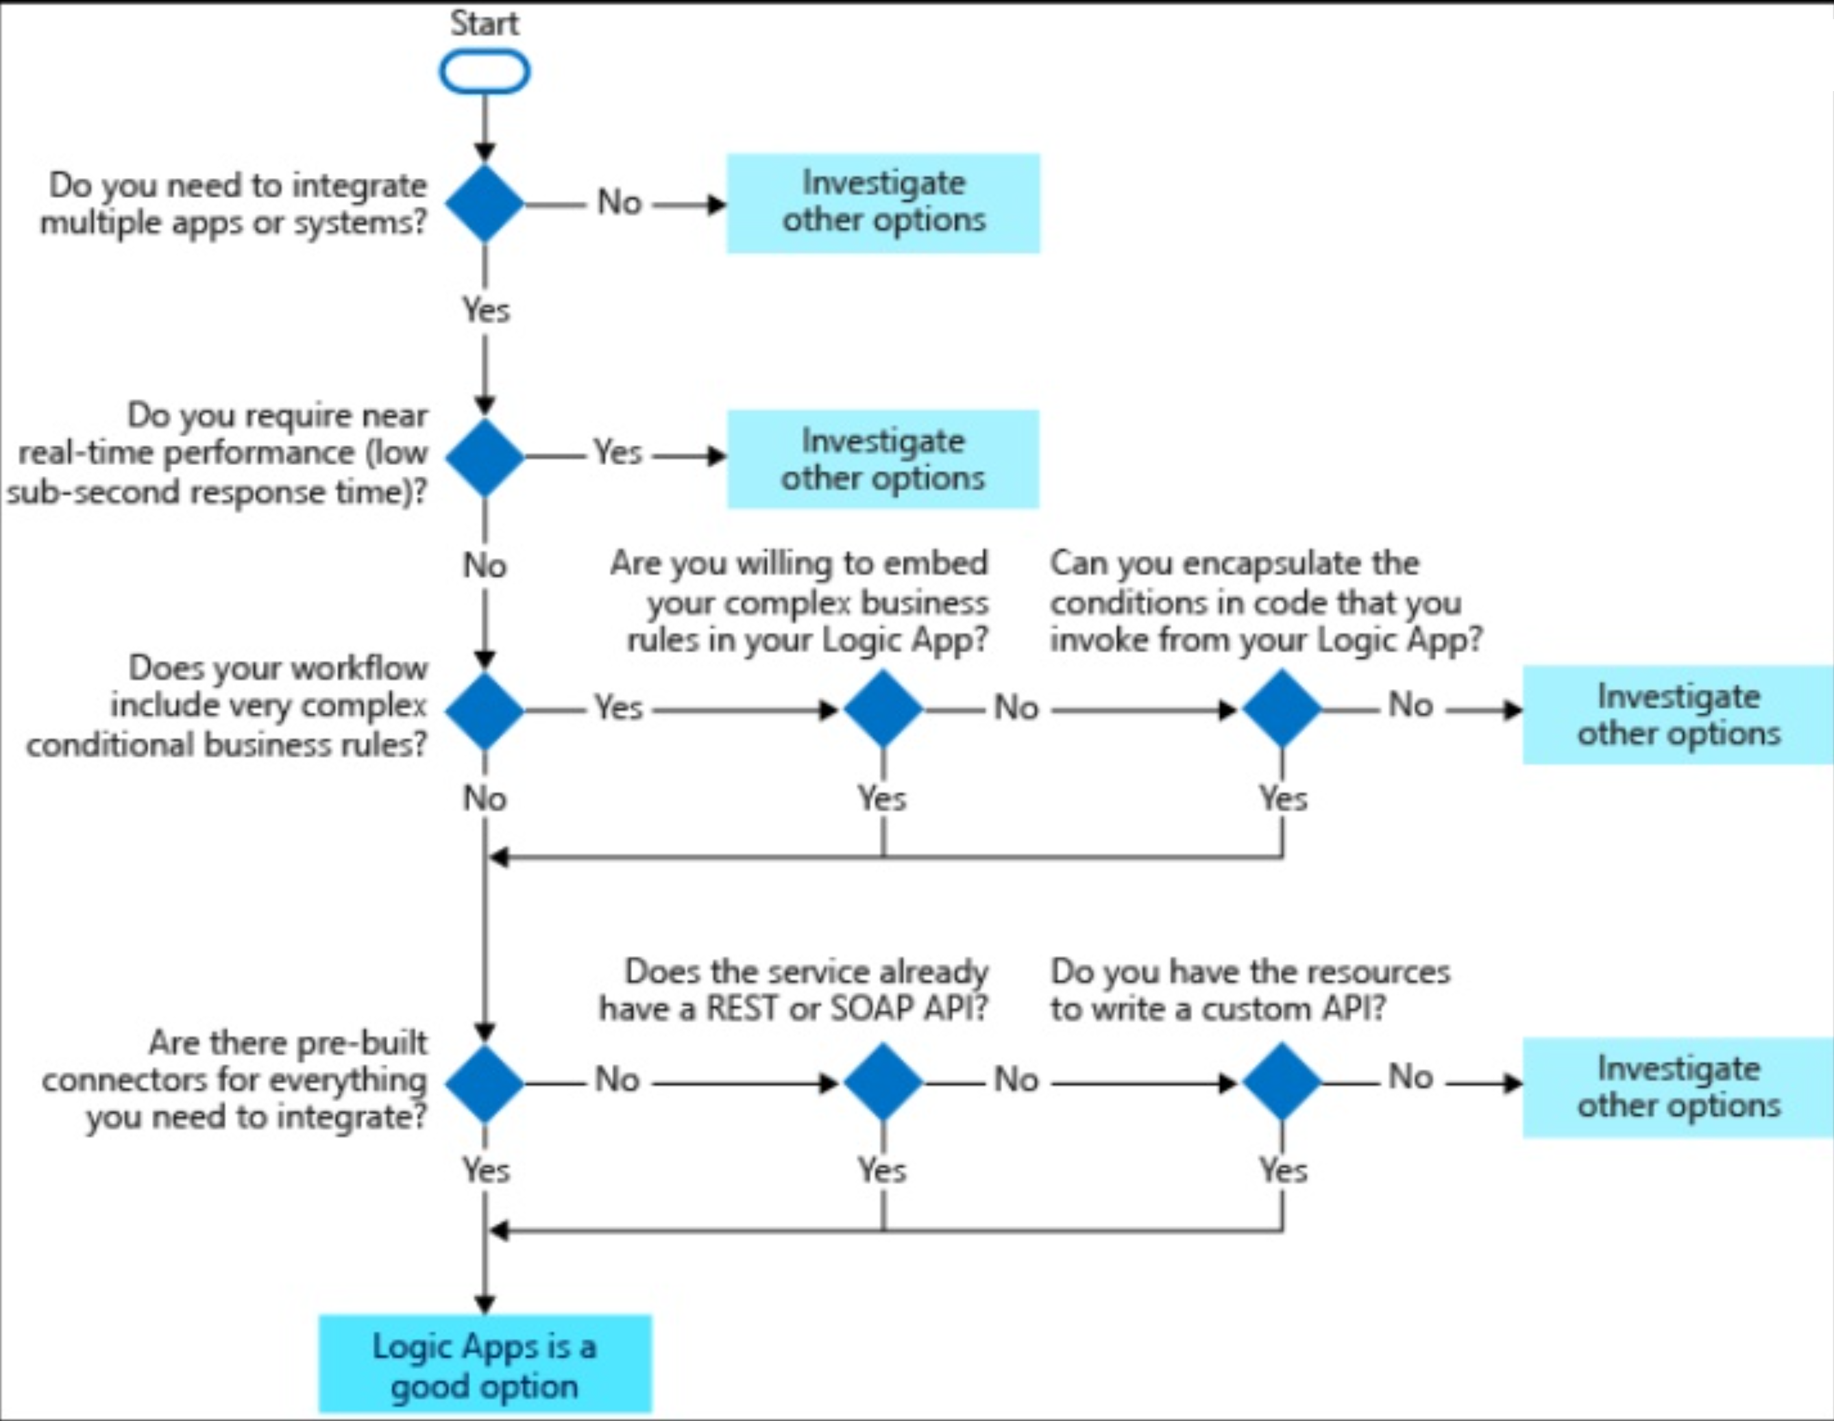
Guidance Chart

Slide 32
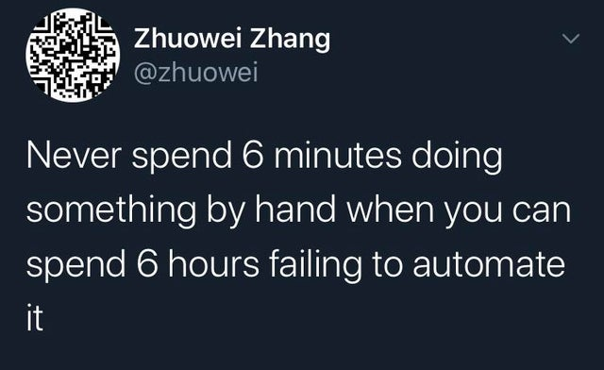

Slide 33

Logic Apps vs Azure Functions
Logic Apps
Azure Functions
Runs a workflow
Only supports visual designer / JSON editor
>200 connectors
Executes a piece of code
Supports multiple languages
Minimal connectors

Slide 34
How does it compare to…
Zapier
IFTTT
Pros of Zapier:
Some connectors that LAs don’t have
Friendly interface
Cons:
Free tier only allows 2 steps
$20/month min
Some functionality is reserved as premium tier
Can’t be integrated into CI/CD pipeline
Security?
Pros of IFTTT:
The “OG”
Friendly interface / Set Forget
Cons:
Little behind on connectors
Set price starts around $4/month for unlimited creation & multi-step
Can’t be integrated into CI/CD pipeline
Security?

Slide 35


Slide 36
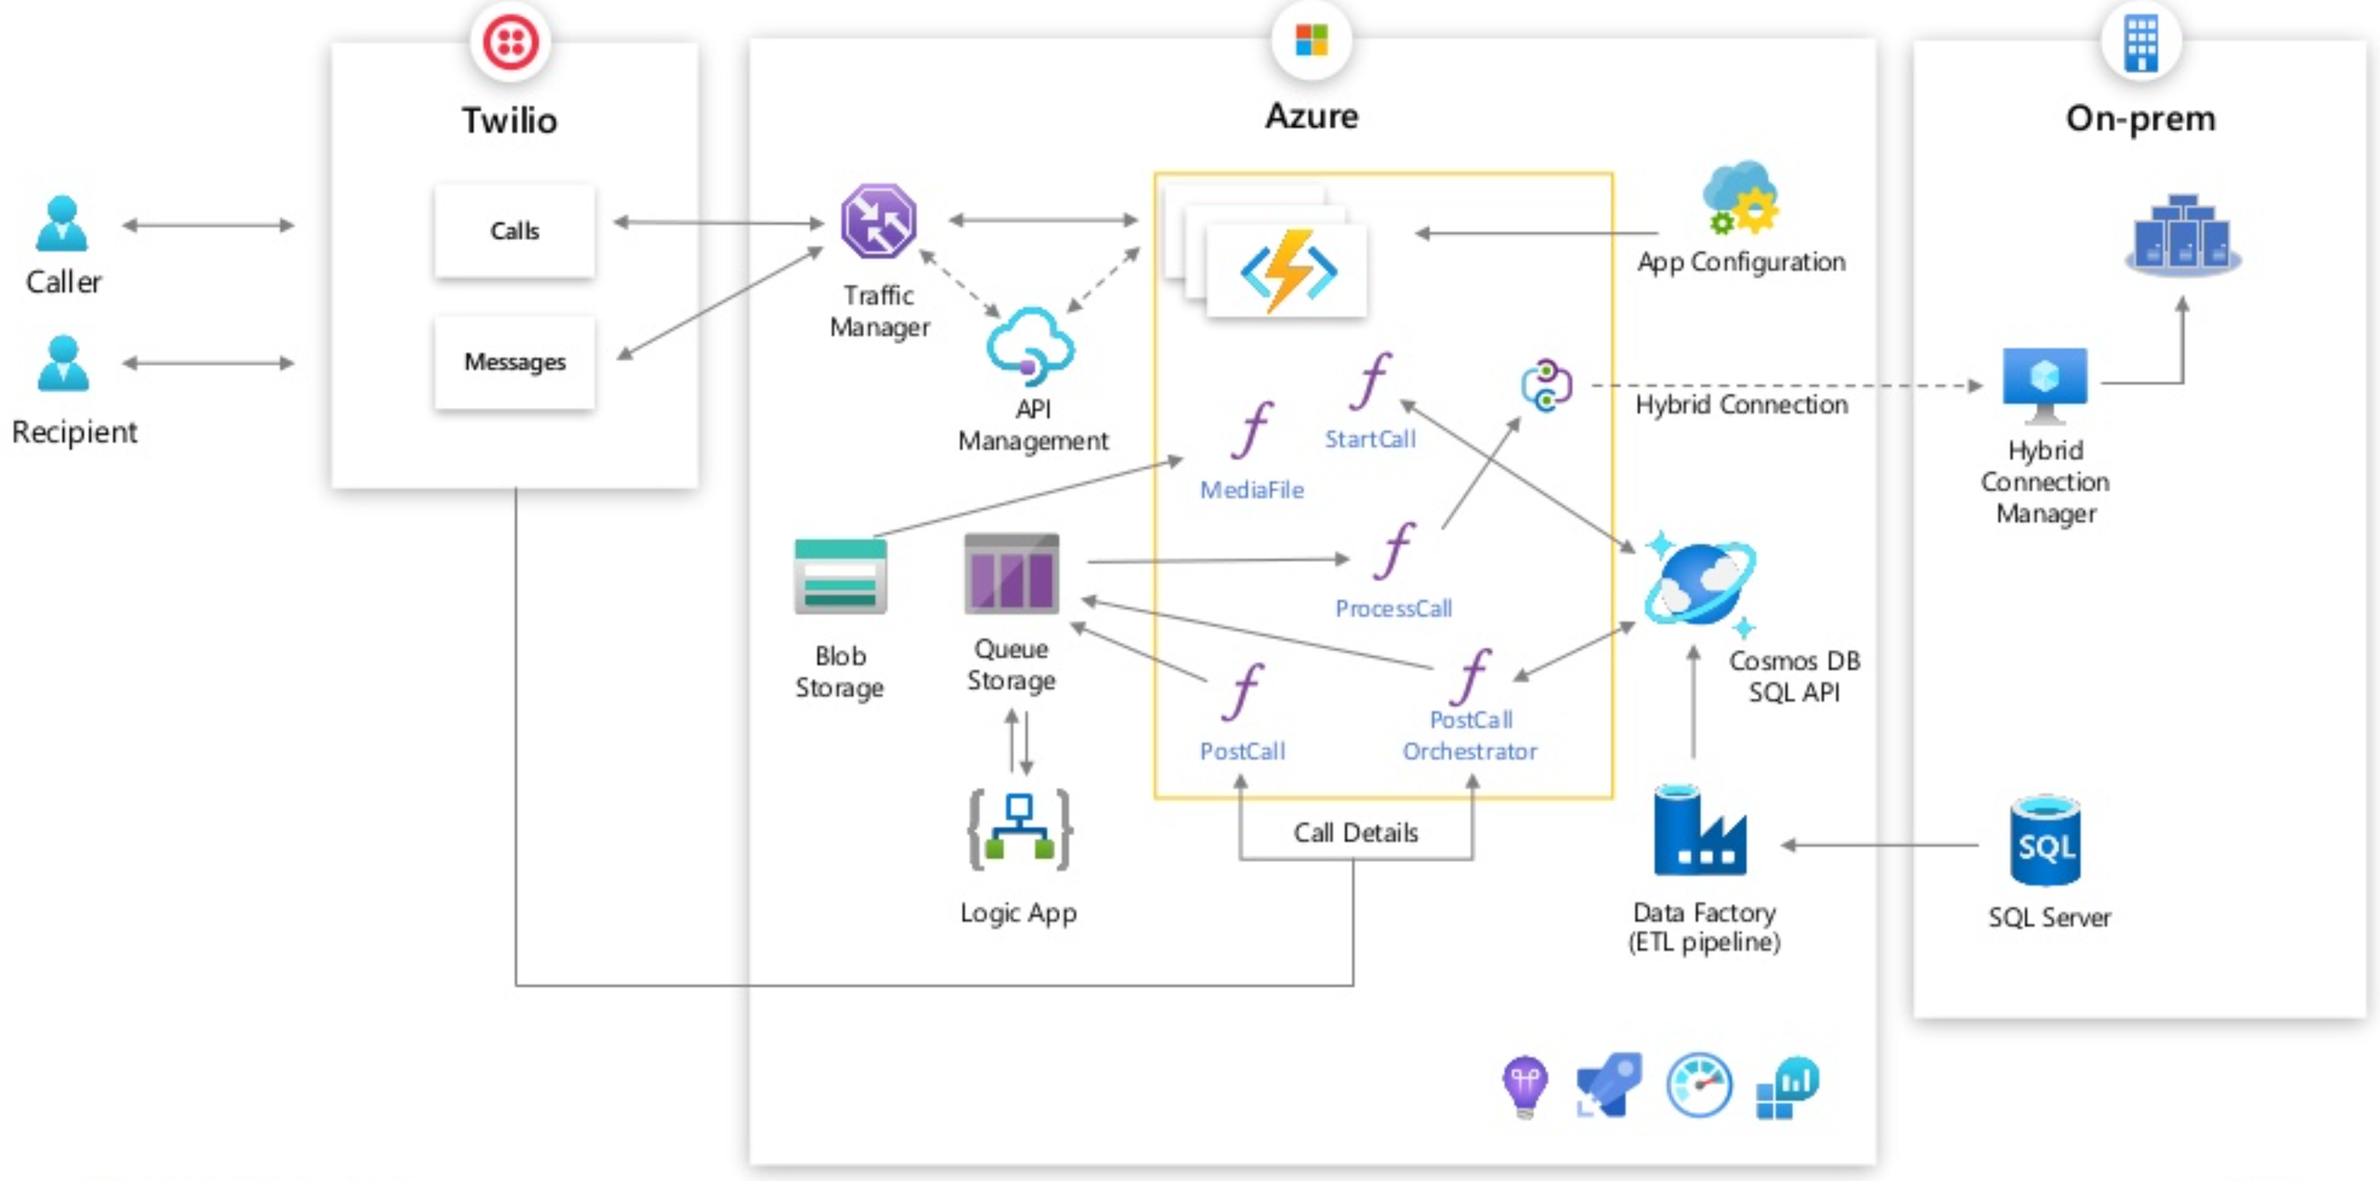
Real World: How it all fits

Slide 37
Questions?

